Slide 1
The importance of reliable sources
Week 2
Lecturer’s Version

Slide 2
Learning Outcomes
To understand and be able to explain the concepts of ‘fake news’, ‘unreliable sources’ and ‘reliable sources’.
To be able to use strategies to identify if a news story is fake, unreliable, or reliable.
To understand the importance of using and sharing reliable sources.
To conduct an online search

Slide 3
Articulation
This class helps you to identify reliable sources. You will be asked to do this in your assessment. You need to be able to do this in all your courses at university. It is also an important life skill for your future employability, as being able to assess the reliability of information is essential for many jobs.
Employability Skills enhanced by this class: IT skills, analytical skills, decision making and data handling
Useful reading: How to Use Your Reading in Your Essay (Godfrey) How do you decide what to read p.8-9

Slide 4
Activity 1: Self-Assessment
Before we begin today’s session, turn to activity 1 on your class handout. Have a look at the learning outcomes and assess your confidence in them.
To understand and be able to explain the concepts of ‘fake news’, ‘unreliable sources’ and ‘reliable sources’.
To be able to use strategies to identify if a news story is fake, unreliable, or reliable.
To understand the importance of reliable sources.
To understand how to conduct an online search.

Slide 5
Activity 2: What is fake news?
You may have heard this term many times over the last few years. Go to your Handout, Activity 2, and discuss the questions with your group.
What is fake news?
When did fake news begin and why has it become more significant in recent history?
Can you think of some examples of ‘fake news’?
How do you know if a news article is trustworthy?

Slide 6
Activity 2: What is fake news? – Answers
1. What is fake news?
“False information that is broadcast or published as news for fraudulent or politically motivated purposes.” (Oxford Dictionary, 2022)
“[P]rovably incorrect information spread with the goal of fraud” (Saleh, Alharbi & Alsamhi, 2021)
“[F]abricated stories masquerading as legitimate news reports, produced either for profit or for political ends. (Nielsen & Graves, 2017).
Most academics and journalists agree that fake news is politically motivated. Poor or biased journalism, misleading advertising, or malicious hoaxing are not usually considered fake news by experts, though they are by many members of the public (Nielsen & Graves, 2017).

Slide 7
Activity 2: What is fake news? – Answers
2. When did fake news begin and why has it become more significant in recent history?
Spreading false news has likely existed for as long as human society has.
The first recorded use of the term dates back to the 19th century.
The phrase has become more prominent over the last ten years as the internet and social media websites have become easier to access.
“We currently live in an era in which technology enables information to reach large audiences distributed across the globe, and thus the potential for immediate and wide-spread effects from misinformation now looms larger than in the past” (Southwell et al., 2017, p.368)

Slide 8
Activity 2: What is fake news? – Answers
3. Can you think of some examples of ‘fake news’?
The 2020 US Presidential election result was the result of fraudulent ballots.
A mob of 1,000 Muslim men set fire to a historic church in Dortmund.
US paratroopers are fighting Russians in Ukraine.
The Phizer Covid-19 vaccine makes women infertile.
The French Prime Minister wrote to the President of the European Commission asking the EU to punish the UK for Brexit.

Slide 9

Activity 2: What is fake news? – Answers
4. How can you spot the difference between fake and real news?
Let’s watch this video from Quartz News on identifying fake news. Make a note of the tips in the video.

Slide 10
Activity 3 - Video
Watch the Quartz News video again and answer the questions on your handout.

Slide 11
Activity 3 – Video answers
1. What is the best way to know if a news site is trustworthy?
Read a sample of the content on the site, not just one article, and check those other articles are of high quality.
2. Why is it important to look for neutral headlines?
Emotive headlines can affect your ability to think critically.
3. What is the problem with anonymous news stories?
You can’t look up the author’s other work to see if they have a particular agenda.
4. What is wrong with the phrase “scientists say”?
It is vague – it doesn’t tell us which scientists made the claim.
5. How can you check the veracity of images in a news article?
You can do a reverse image search to see if the image has been used in other contexts.

Slide 12


Activity 4: The consequences of misinformation
Do you know what is happening in these pictures?
What misinformation caused this to happen?

Slide 13
Activity 4: The consequences of misinformation
Trump supporters protested, rioted and eventually broke into the US Capitol building, after Donald Trump repeatedly declared that the US election had been fixed.

Slide 14
Activity 4: The consequences of misinformation
Turn to your handout, Activity 4.
There are several examples of fake news stories.
With your group, imagine that an average person read these stories and believed them to be true.
Discuss:
How would reading this article make that person feel?
What might that person do as a result of reading this article?
Why could the article be dangerous?

Slide 15
Activity 4: The consequences of misinformation
Turn to your handout, Activity 4.
There are several examples of fake news stories.
SKY SPORTS SAYS NO MORE MALE FOOTBALL PUNDITS ALLOWED IN BID FOR GENDER EQUALITY
LONDON TAPWATER POISONED IN LARGE-SCALE COORDINATED TERRORIST ATTACK
SADIQ KHAN PLANS TO INSTALL CAMERAS IN EVERY HOME TO MAKE SURE LONDONERS DO NOT BREAK COVID RULES
PARACETAMOL SUPPLIES WILL RUN OUT IN 24 HOURS
DRINKING SMALL QUANTITIES OF BLEACH PROVEN TO BEAT CANCER

Slide 16
Activity 4 - answers
anger, disbelief, shock, upset. People may stop watching Sky Sports/cancel their subscription. Anti-feminist sentiment.
fear and panic, anger. Panic buying of water bottles and hand sanitiser. Prices of water going up. Water shortage. Possible racism in response to ‘terrorism’.
fear, panic, anger, disbelief. People might stop voting for Sadiq Khan. Sadiq Khan could even be attacked/targeted. Protests and violence.
fear, panic. Panic buying of paracetamol leading to a shortage for people who urgently need it. Price increase.
Disbelief, false hope. Some people suffering desperately from cancer may try it. Dangerous for health.

Slide 17
Activity 5: Fake or real?
Now let’s test our ability to identify fake news. Some of the following headlines are true and some are false. First, make a judgment on whether you think the stories are true or fake, then, do some online research to find out.
NASA is installing internet on the moon.
A university banned the use of capital letters to avoid scaring students
Couple in California name baby with emoji
Eight-year-old girl pulls medieval sword from lake
German street covered in chocolate
School bans parents from sports day
Spinach is taught how to send emails
Gorilla learns to knit
NASA is installing internet on the moon.

Slide 18
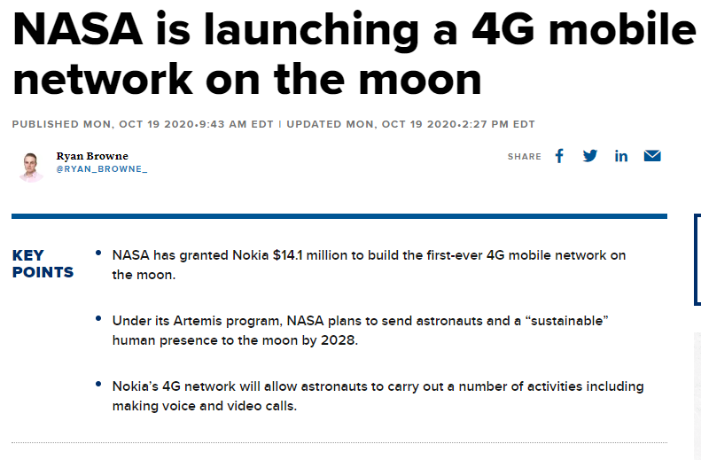
NASA is installing internet on the moon.
Yes.

Slide 19
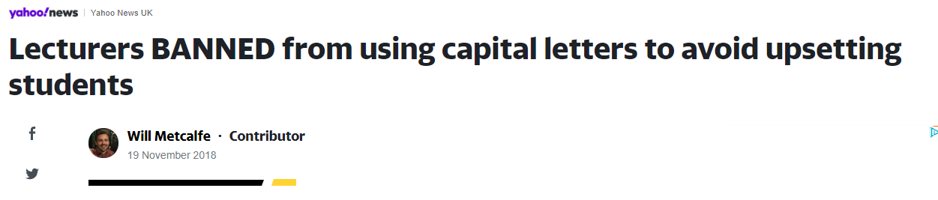
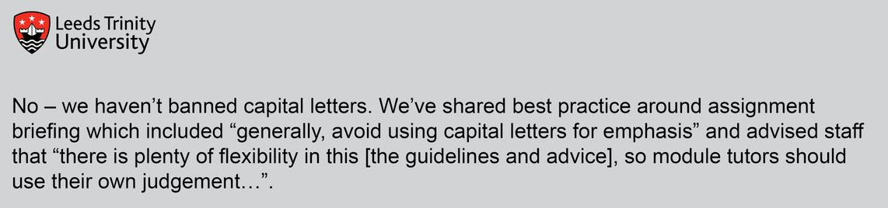
2. A university banned the use of capital letters to avoid scaring students. No
Emotive language and words that express certainty are typical of unreliable sources.

Slide 20
2. A university banned the use of capital letters to avoid scaring students. No
The original language was far more cautious.

Slide 21
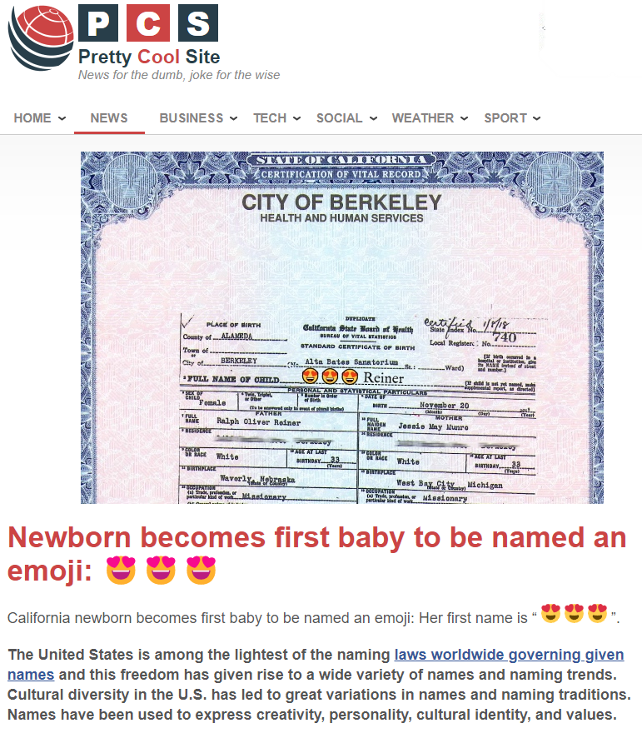
3. Couple in California name baby with emoji No

Slide 22
3. Couple in California name baby with emoji No
Always check were information has originally come from. This is from a satire website.

Slide 23
Eight-year-old girl pulls medieval sword from lake
Yes
A good way to check if a news story is real is to check who is reporting it - this story was reported by The Guardian, the BBC and many other sources.

Slide 24
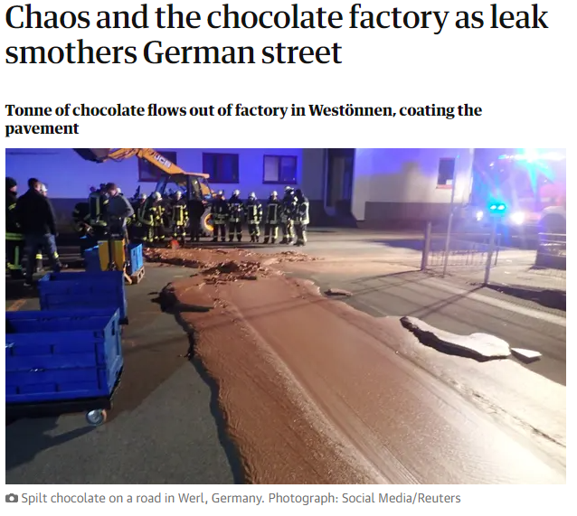
5. German street covered in chocolate
Yes
This delicious accident really happened - a tonne of chocolate leaked from a chocolate factory in Westönnen, covering the pavement. This was reported by The Washington Post, Reuters and The Guardian. Notice the source provided for the photo.

Slide 25
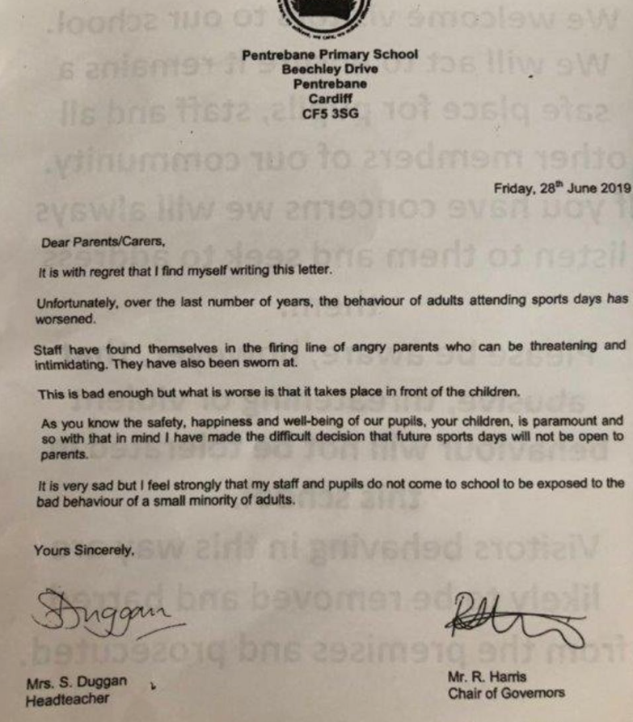
School bans parents from sports day
Yes
This was reported by lots of well-known news sources, like the BBC, The Telegraph and The Guardian. A reverse image search of the letter opposite all relate to the same story.

Slide 26
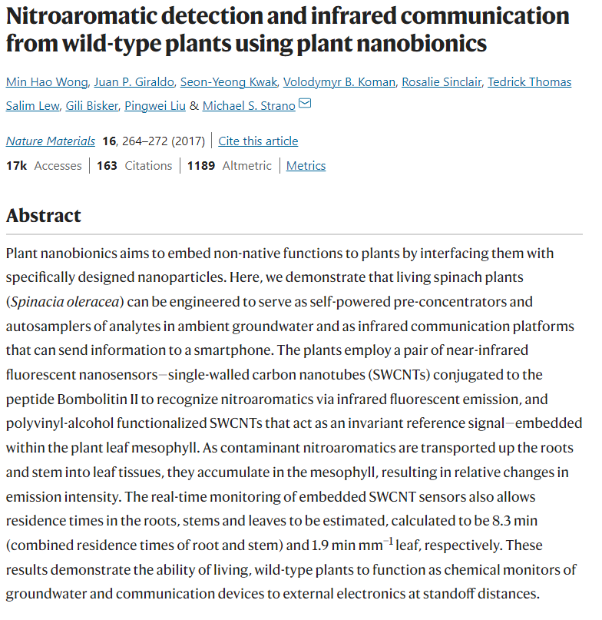
7. Spinach is taught how to send emails
Yes…ish
This story comes from a research paper published in the academic journal Nature Materials. This makes it very trustworthy.
However, the article states that the spinach has been engineered (not taught) to send information to a smartphone. The title comes from a newspaper headline and is misleading. It is always important to read the full article or check out the original source for a story.

Slide 27
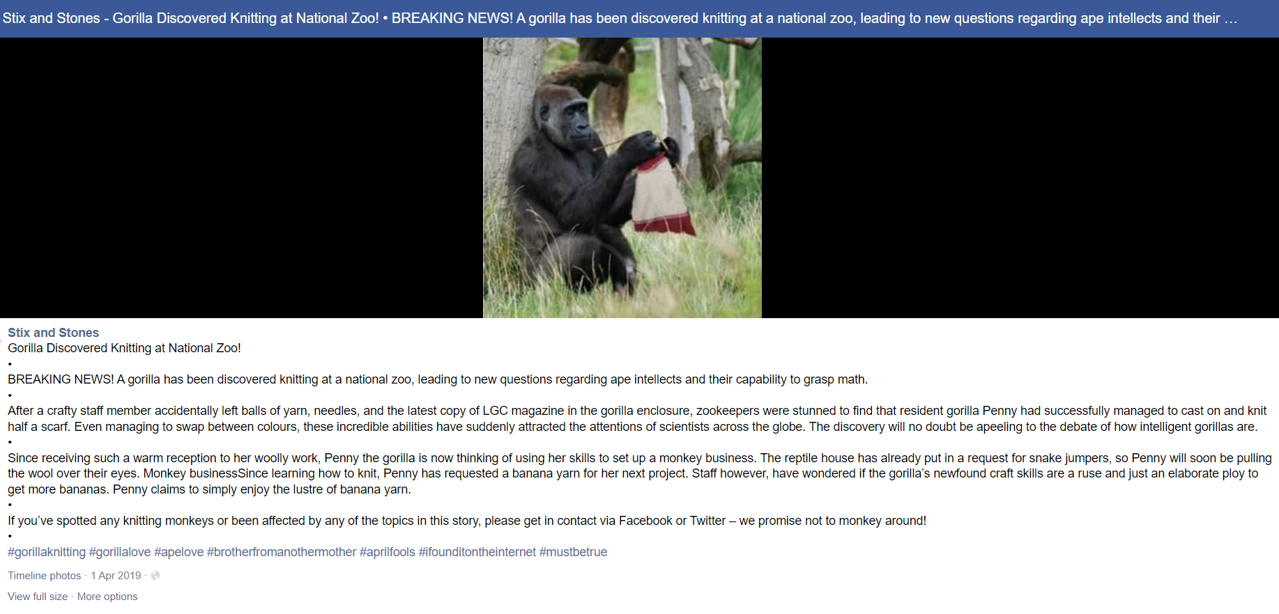
8. Gorilla learns to knit
No

Slide 28
Unfortunately this was just an April Fools’ joke that went viral.
8. Gorilla learns to knit
No

Slide 29
Activity 6: Unreliable vs Reliable news
You will now listen to a short lecture about how to tell the difference between unreliable and reliable news.
Go to Activity 6 on your Handout, and make notes on the questions.
After the lecture, you will have a chance to discuss your answers with your classmates, and ask your lecturer any questions you have.

Slide 30
Activity 6: Unreliable sources and bias
Once you have established that a story is based on fact, and is not fake news, you also need to think about whether the article might be biased.
Biased sources often present a story from one point of view. Biased news articles want to convince or persuade the reader of a certain opinion.
For example, pro-Brexit newspapers rarely mention the negative effects of leaving the EU when discussing the cost of living crisis.

Slide 31
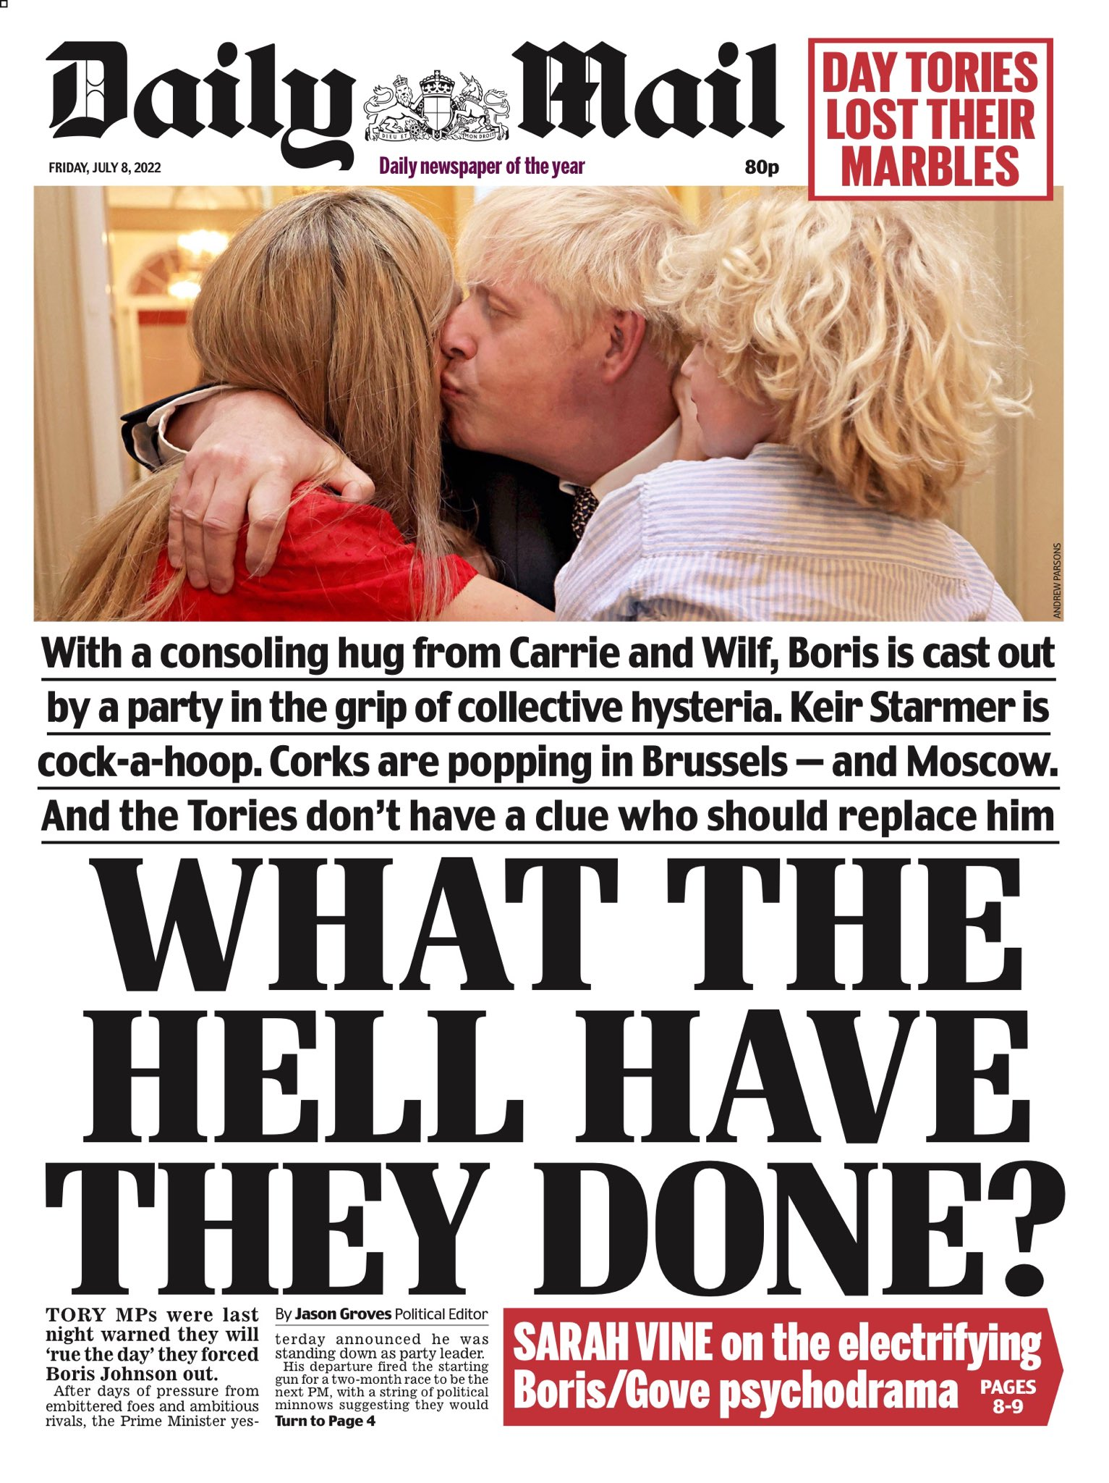
Activity 6: Unreliable sources and bias
Let’s look at some examples.
These different newspaper reports are about the ousting of Boris Johnson.
The Daily Mail describes Johnson as being ‘cast out’, his party as being hysterical, and asks ‘What the hell have they done?’ The image used is also very sympathetic, showing the former Prime Minister being hugged by his family.

Slide 32
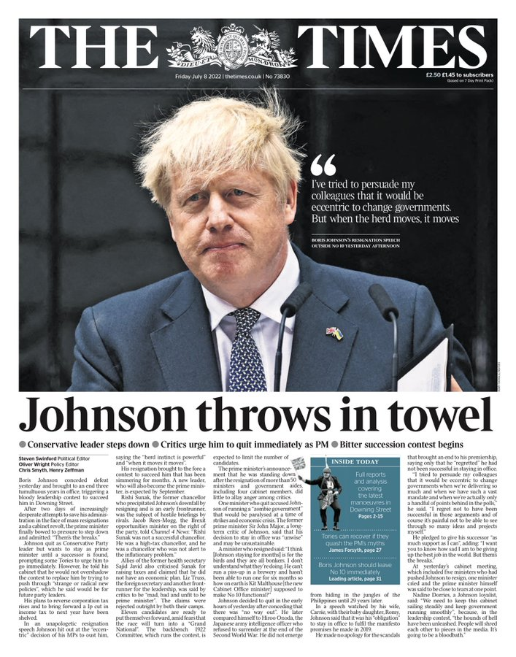
Activity 6: Unreliable sources and bias
The Times uses less emotional language. Rather than being ‘cast out’, Johnson has ‘stepped down”.
The Times also focuses on what the PM actually said.
What effect do these different uses of language have?

Slide 33
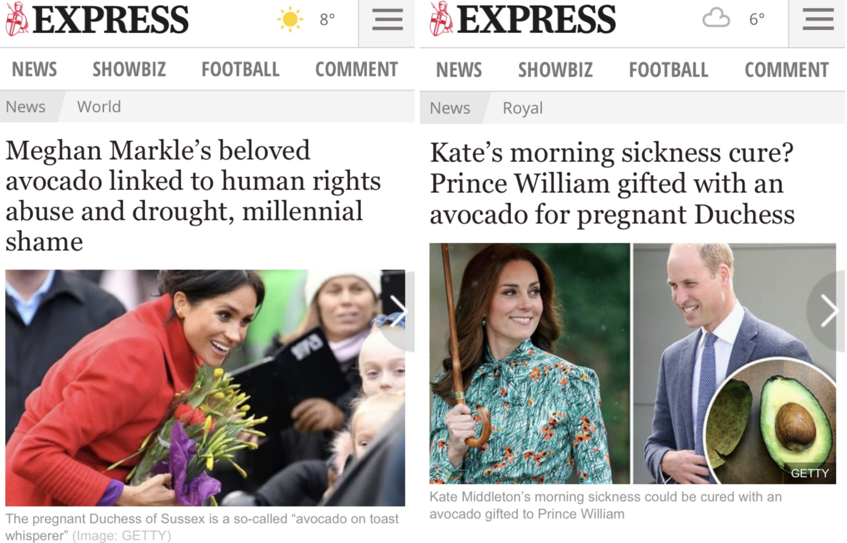
Activity 6: Unreliable sources and bias
Here is another example of biased newspaper reporting.
What do you notice that is different about the way The Express talks about Meghan Markle and Kate Middleton?

Slide 34

Kate’s use of avocado, on the other hand, is seen positively – as a way to deal with morning sickness.
Meghan’s use of avocado is associated with negative traits.

Slide 35
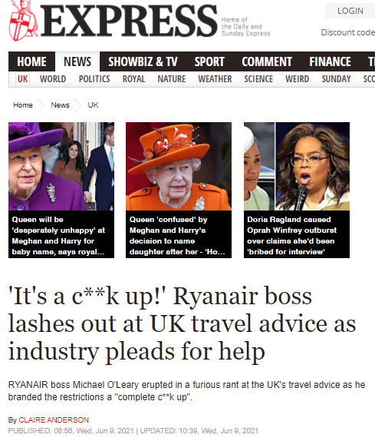
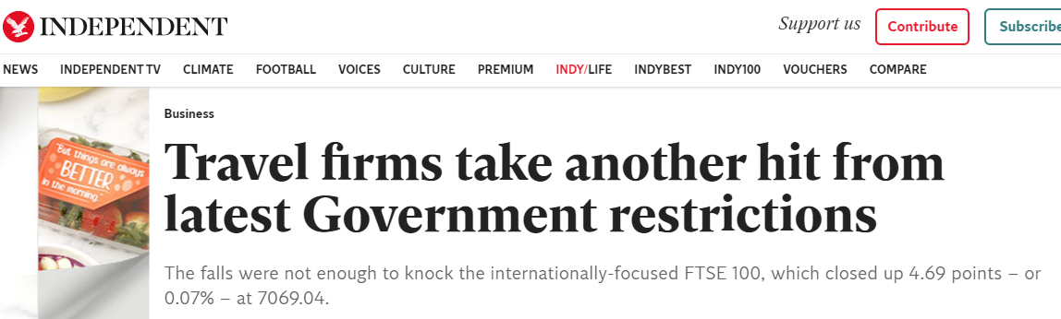
What differences can you see between the language in The Express and The Independent?

Slide 36
The Express:
Focuses on the personal: the opinion of the Ryanair boss
Includes swear words
Is emotional – ‘lashes out’, ‘pleads for help’, ‘a furious rant’
Suggests the reader should be angry too
The Independent:
Does not focus on emotions – it focuses on the business aspect of new travel restrictions and the FTSE 100
Doesn’t enforce an opinion
on the reader

Slide 37
Activity 6: Reliable news websites
Therefore, when reading a news story you should check if the story has been reported on reputable news websites. In the UK, these include BBC News, Sky News, ITV News, Channel 4 News, The Times, The Guardian, The Independent, the Economist, and the Financial Times.
These websites might have a slight political bias, but they do not generally use exaggerative or emotional language.
You will see quotes in the articles from important people and experts such as politicians, spokespersons, scientists and researchers. These people are likely to be qualified to speak about expert topics.
Even if a news website is reputable, you should always look out for emotional and opinionated language. If the language is emotional, is it because the article is biased, and it is trying to make you agree with their point of view?

Slide 38
Activity 6: Unreliable news websites
Some news websites such as The Daily Mail, The Daily Express, The Sun and The Mirror do not necessarily publish fake news, but they are often unreliable.
Firstly, they often exaggerate stories and use emotional language to sell more papers.
Secondly, they also often have a strong political bias.
In these news websites, you might see journalists say that the information came from ‘an unnamed source’ or ‘someone close to the person’ – but there is no name. This makes it difficult to prove if the journalist has made up or exaggerated the information.

Slide 39
Activity 6: Fake news websites
Finally, there are some websites which look like real news websites, but they might be fake.
They usually have a lot of adverts, as the website makes money from people clicking on the links and viewing the adverts.
They will probably use a lot of emotional and opinionated language.
The more controversial and emotional the news stories, the more likely people are to click on them.
These websites do not aim to inform people of the truth; they aim to either misinform (e.g. for political reasons), or to get people to click on the news stories to make money for adverts.

Slide 40
Activity 6: Spotting fake news
Many reputable news websites, including BBC News and The Guardian, now have ‘fake news fact-checker’ features.
https://www.bbc.co.uk/news/topics/cjxv13v27dyt/fake-news
You can use these features to help you get more information about a story and form your opinion.

Slide 41
Activity 6: Spotting fake news
The most important things to remember throughout your studies and throughout your career are…
1. We should not get all of our information from one source.
2. We should question what we read, and see if we can find any information elsewhere that supports it, or contradicts it.
3. We should examine the language of what we read. If the language is emotional or opinionated, we need to think carefully about whether we agree with that opinion.
The more widely you read, the more likely you are to get an accurate, truthful, and comprehensive understanding of a situation.
This is good practice for your future studies.

Slide 42
Summary of tips for spotting fake news.
Check the news source is up to date. Is the article you are reading a recycled story from a few years ago or using old images.
Check that all the information in the article is relevant. For example, is the fact that a robbery is committed by a person of a particular ethnic group important to understand the news?
Check who wrote the article. Are they a well known journalist who works for a prestigious news organisation.
Check the article’s accuracy. Are other news media reporting the same facts? Does the article tell you where it is getting its information from?
Check the intentions behind the article. Do you think the article is trying to push a particular agenda or get you to buy something?

Slide 43
How does all of this relate to my course?
Good question!
In academia, whenever you write or present, you need to support your points with reliable sources.
As we have seen, identifying fake news is a first step. Being aware of bias is also important.
Other things to look out for in a reliable source are:
Named sources
non-biased sources
current sources

Slide 44
Online Searches
Often an online search on a search engine like Google can come up with a mix of reliable and unreliable sources.
You can tell a lot about the reliability of a source just by looking at the URL

Slide 45
What can I tell from the URL?
URL | Meaning | Reliable/unreliable / caution required
.ac | academic | Reliable
.com | commercial | Be cautious. Is this site trying to sell you something? Is it biased?
.org | Not for profit organisation | Be cautious. Does this site have a particular agenda that it is promoting.
.gov | A government website e.g council | Likely to be reliable
blog | An informal discussion or information based website. | Unreliable as this is often opinion based. Anyone can write a blog.
wiki | A website where content is collaboratively modified | Unreliable as anyone can contribute to this platform.

Slide 46
Next Steps
Once you are happy with the URL, then take a closer look:
Remember, in terms of reliability we are looking for:
Named sources (Who wrote the source?)
Checked sources (Has the information been verified?)
non-biased sources (Is this a tabloid newspaper or an organisation who wants me to think in a certain way?)
Current sources (Is this up to date. Or has the information already changed?)

Slide 47
Problem Solving – I can’t find the author
This often happens with websites.
If the site is associated with a reputable institution such as a respected university, a credible media outlet, government program or department, or well-known non-governmental organizations, it is ok to use
Avoid sites like Wikipedia which are collaboratively developed by users. Because anyone can add or change content, the validity of information on such sites does not meet the standards for academic research.

Slide 48
How do I know if a source has been checked?
Books are checked as part of the editing process
Academic journals are ‘peer reviewed’ as part of the publishing process.
Newspapers are only checked for typos. Some papers have more integrity than others.
Websites are not usually checked.

Slide 49
How do I know if a source is biased?
As we saw earlier, have a look at the language.
Who is the organisation/ author? Do they have a particular agenda they want to push?

Slide 50
I can’t find the date/ how old is out of date?
This can happen when using websites. If there is no obvious date, scroll down to the very bottom of the page and use the date you find there.
The age of a source depends on the topic you are writing about. For example, if you are writing about the Corona Virus, a source from 2020 is likely to be out of date.
If you are writing about business ethics, then sources within the past 10 years are probably ok to use, but of course you need to use your judgment on this.

Slide 51
Activity 7 – Online Search
A student has been tasked with writing about Covid vaccine reticence*.
(*Reticence = unwillingness to do something)
Look at the results of an online search and decide which sources are reliable and which ones are not.

Slide 52
Activity 7 – Source 1
COVID-19, Vaccination and Vaccination Hesitancy in Africa ...
https://www.psychologytoday.com/us/blog/global-events/202106/covid-19...
2 days ago · This blog was co-authored with Prof Ashraf Kagee, a member of the Western Cape COVID-19 Vaccine Expert Advisory Committee, South Africa. COVID-19 was first detected in …
What can you tell from the URL? It is a blog, therefore unreliable
Don’t waste anymore time – move on

Slide 53
Activity 7 – Source 2
COVID-19 Vaccines and Pregnancy - COVID-19 - Johns Hopkins ...https://www.jhsph.edu/covid-19/articles/covid-19-vaccines-and-pregnancy.html29/03/2021 · This article originally appeared on the Johns Hopkins University Coronavirus Resource Center. Globally, over 200 million people are pregnant each year. Whether they should be offered the new
What can you tell from the URL? The source is a university hospital with a reputation for research
Named sources (Who wrote the source?) Ruth Faden, Elana Jaffe, Carleigh Krubiner, and Chizoba Wonodi (experts in the field)
Checked sources (Has the information been verified?) The source refers to other studies
Non-biased sources (Is this a tabloid newspaper or an organisation who wants me to think in a certain way?) Not Biased
Current sources (Is the source up to date?) March 2021 – seems to be up to date, however the article claims that there is an ‘absence of data’ on pregnant – specific covid vaccines, this is no longer the case. This is a fast moving situation, so always check for the latest updates.
This is a reliable source but make sure you are using the most up to date information on situations that are changing rapidly.

Slide 54
Activity 7 – Source 3
NHS workers join anti-vax Facebook group that claims ...
https://www.thesun.co.uk/news/13208307/nhs-workers-anti-covid-vaccine...
16/11/2020 · HUNDREDS of NHS workers have joined an anti-vax Facebook group claiming the coronavirus vaccine is a "poison" set to be "unleashed" on the …
What can you tell from the URL? The Sun is a tabloid newspaper and is unreliable. Language such as ‘poison’ and ‘unleashed’ should also be a red flag.
Don’t waste anymore time – move on

Slide 55
Activity 8: Putting it into action
You have been asked to write an essay about the gender pay gap.
Do an online search and find 2 reliable sources.
Find out how to bookmark your sources on your device. It might be by clicking on the star icon at the top of your browser, or perhaps your computer has a book icon.
Share your ideas with your group.
Why do you think your source is reliable?

Slide 56
Activity 9: Reflecting on learning outcomes
Go back to the learning outcomes in activity 1.
Reassess your confidence in them.

Slide 57
Self – Assessment Follow up
If you have ticked ‘I don’t know what this means’ or ‘I know what this means, but I can’t do it’, you must take action:
Review the class materials.
Make sure you have answered all of the questions on the class handout – check your answers against the lecturers’ version.
Be sure to take the quiz.
Do the suggested reading.
If you are having IT issues or cannot log on to the library, contact Online Support on the VLE.
Please be aware that these skills will be practised throughout the course, so if you are not 100% confident, don’t worry, you will have plenty of chances to practise. If you do feel confident, that’s great – by the end of the course you will be an expert!

Slide 58
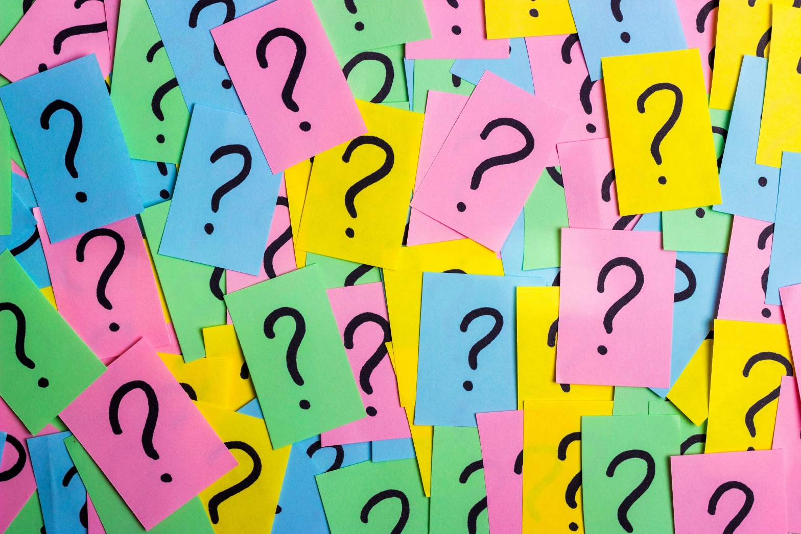
Q&A- Now is your opportunity to ask any questions.

Slide 59
Homework
Reading: How to Use Your Reading in Your Essay (Godfrey) How do you decide what to read p.8-9
Resolve any outstanding IT issues
Take the quiz on the VLE
Watch this short video before you do the quiz, it will help you.
https://www.youtube.com/watch?v=HxS7FJo8HIM

